Slide 1

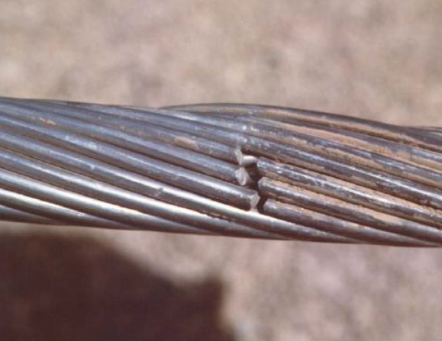
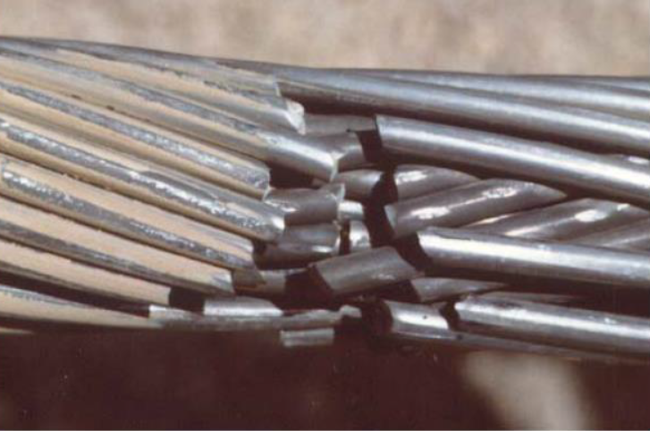
INFLUENCE OF TRANSMISSION LINE CABLE WITH IN LINE FITTINGS SYSTEM MATRIX EIGENVALUES DETERMINATION ON CABLE FATIGUE LIFE ASSESSMENT
ICSID 2021
5th International Conference on Structural Integrity and Durability Dubrovnik, Croatia, September 7 - 10, 2021
H. Wolf, S. Singer, Ž. Božić
University of Zagreb, Faculty of Mechanical Engineering and Naval Architecture, Ivana Lučića 5, 10000 Zagreb, Croatia, hwolf@fsb.hr
Transmission line Aeolian vibrations are usually noticed at frequencies 5-60 Hz for low to moderate wind speeds (1-7 m/s).
Fatigue of cable strands is the most common form of damage resulting from Aeolian vibrations and it occurs at points where motion of cable is constrained against transverse vibrations (suspension clamps, Stockbridge damper clamps, spacer-damper clamps.
The first and crucial step of applying Modified Energy Balance Method (usually used for transmission line Aeolian vibration response determination) is accurate determination of the system matrix J(s) eigenvalues
After the eigenmodes are determined, vibration amplitudes and cable bending stresses can be determined from the energy balance among the power of aerodynamic forces brought into the system, the power dissipated by the vibration dampers, and the power dissipated by the conductor due to conductor’s self-damping.
Based on the obtained results, which significantly depend on statistical distributions of wind speed, wind direction and turbulence level of the wind flow, Maximum stress or strain approach or Minimum lifetime estimation can be used for cable risk assessment.
Various algorithms for the computation of all eigenvalues of J(s) in the natural domain are given in literature. However, it should be emphasized that the determinant search and the nonhomogeneous system solution method (NSS) suffers from lack of accuracy. There are many far more stable numerical methods which can determine the singularity of a matrix. For example, these methods include the QR factorization with column pivoting, or the singular value decomposition (SVD).
The presented results are related to ACSR ’’Bersfort’’ 35.6 mm (48/7) with 6 Stockbridge dampers and 3 warning spheres
Span with 6 Stockbridge dampers and 3 warning spheres
Absolute values of cable bending stresses at left and right suspension clamp obtained by NSS
Absolute values of cable bending stresses at left and right suspension clamp obtained by SVD_OPT
Presented numerical example illustrates that mode shapes of the considered symmetrical structure obtained by the developed numerical procedure (SVD_OPT) are, as expected, either symmetric or antisymmetric.
Precise determination of the parameter s is crucial for reliable Aeolian vibrations analysis and cable fatigue life assessment.

